Slide 1


HOME MANAGEMENT
SYSTEM
This presentation explores the development and implementation of a home management system for efficient and organized household management.

Slide 2
Scope
· In home all members require many Document which represent their status and category.
· Each member has many different income sources, account and description.
· Members has one or many expenses which have different amount and category.
· Many investment has done by member which have different market value and risk level.
· House member have many different roles which include responsibility, permission etc.
· Many member stay in house.
· House requires many services for maintaining the status of house.
· Those services are provided by provider in order to Fulfill availability and show specialization.
· House require many security for protection of members, and it is attend by having alert, notification and alarm setting.
· For proper maintained, house has one budget by which we get to know about status of amount.
· House requires many inventory item which have their storage ,quality and prices

Slide 3
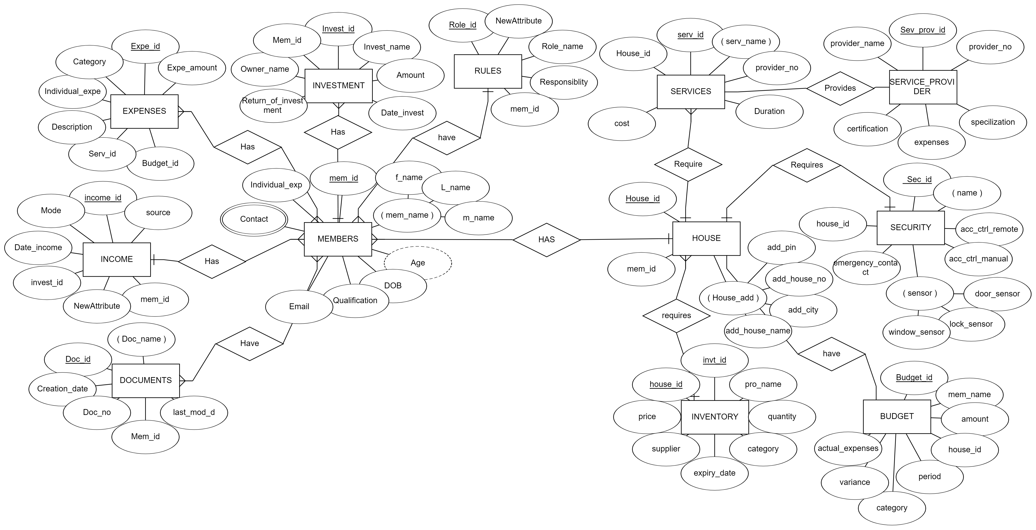
ER Diagram

Slide 4
Tables
INVESTMENT(INVESTMENT_ID , INVESTMENT_NAME , DATE_OF_INVESTMENT , MARKET_VALUE , RISK_LEVEL , AMOUNT , OWNER , RETURN_DATE_OF_INVESTMENT , MEM_ID)
ROLES(ROLE_ID , ROLE_NAME , STATUS , RESPONSIBILITY ,PERMISSION , CATEGORY , START_DATE , END_DATE , MEM_ID )
EXPENSES(EXP_ID , DATE , CATEGORY , AMOUNT , DESCRIPTION , INV_ID , SER_ID , BUDGET_ID , INDIVISUAL_EXP)
INCOME(INC_ID , SOURCE , FREQUENCY , DATE , AMOUNT , MODE , INVESTMENT_ID , MEM_ID )
DOCUMENT(DOC_ID , DEPARTMENT , STATUS , AUTHOR , CREATION_DATE , LAST_MODIFICATION_DATE , OWNER , TITLE , CATEGORY , MEM_ID , )
INVENTARY_ITEMS(INV_ID , NAME , QUANTITY , CATEGORY , WARRENTY_DATE , WARRENTY_DURATION , SUPPLIER , PURCHASE_DATE , PRICE , HOUSE_ID )
BUDGET(BUDGET_ID , CATEGORY , NAME , AMOUNT , STARTR_DATE , END_DATE , ACTUAL_EXPENSES , OWNER , VARIANCE , CATEGORY , HOUSE_ID)
SECURITY(SEC_ID , NAME , ACC_CONTROL_REMOTE , ACC_CONTROL_MANUAL , EMERGENCY_CONTACT , STATUS , PANIC_BUTTON_SENSOR , DOOR_SENSOR , WINDOW_SENSOR , SMART_LOCK_SENSOR , VIDEO_DOORBELL_SENSOR , HOUSE_ID)
SERVICES(SER_ID , NAME , COST , PROVIDER_CONTACT , SCHEDULE , FREQUENCY , STATUS , DURATION , SER_PRO_ID , HOUSE_ID)
SERVICE_PROVIDER(SER_PRO_ID , NAME , CONTACT_NO , CONTACT_LOCATION , SPECILIZATION , RATING , PRICE ,CERTIFICATION)
HOUSE(HOUSE_ID , NAME , ADD_HOUSE_NO , ADD_CITY , ADD_STREET , ADD_PIN , MEM_ID)
MEMBERS(MEM_ID , NAME , AGE , DOB , QUALIFICATIONS , EMAIL_ID , CONTACT_NO , GENDRE , INDIVISUAL_EXP)
MEM_DOC_ID ( MEM_ID , DOC_ID)
MEM_ EXP ( MEM_EXP_ID , MEM_ID , EXP_ID )

Slide 5

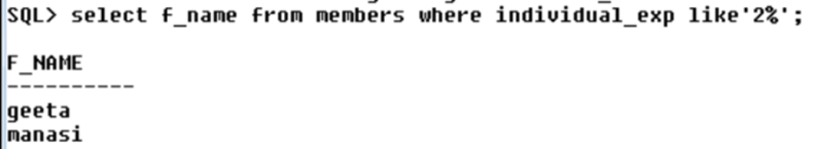
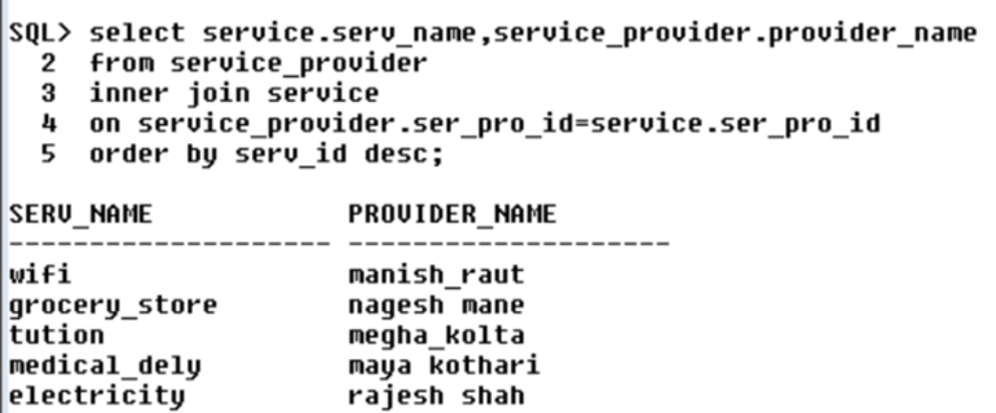
Queries
which member spends amount of money starts with the digit 2?
display the service name and its provider name

Slide 6

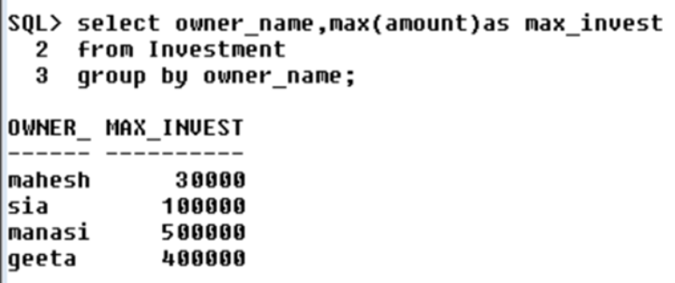
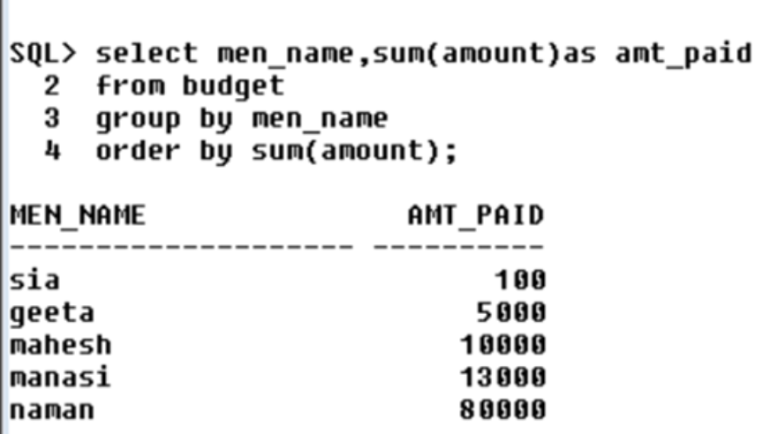
Queries
which member has the maximum investment and what is that amount?
what is the total amount paid by a member in the house budget from least to most?

Slide 7

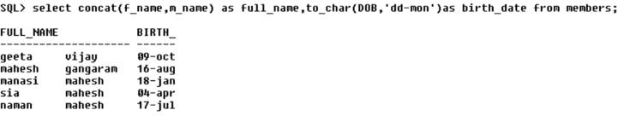
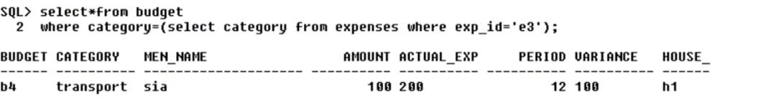
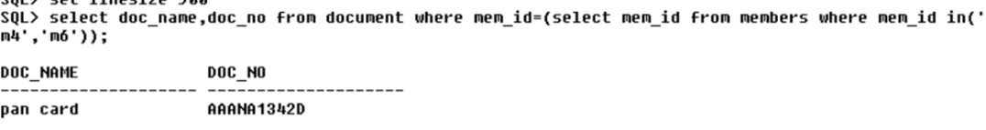
Queries
concatenate the first name and middle name of the members and there age.
display the details of the budget where expense id is e3
display the document name and number where the member id is m4 or m6

Slide 8

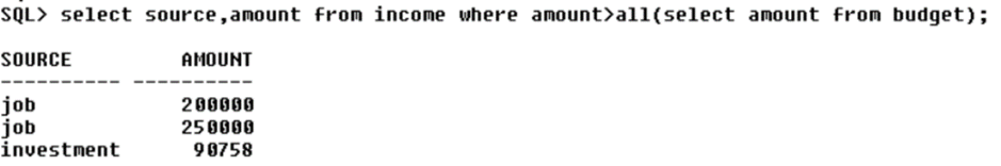
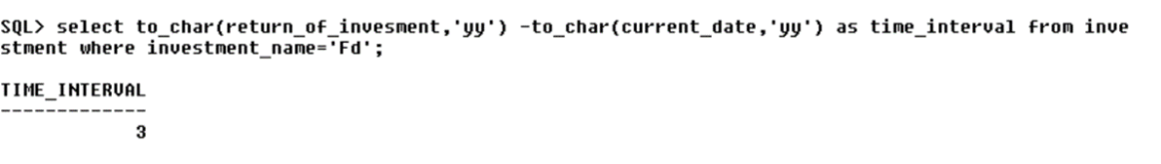
Queries
display the source and amount from income where it is greater than all the budget amount
how much years are left for maturing the fd.

Slide 9

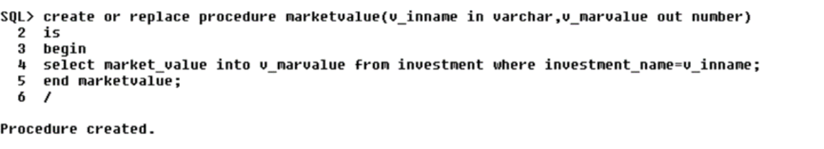
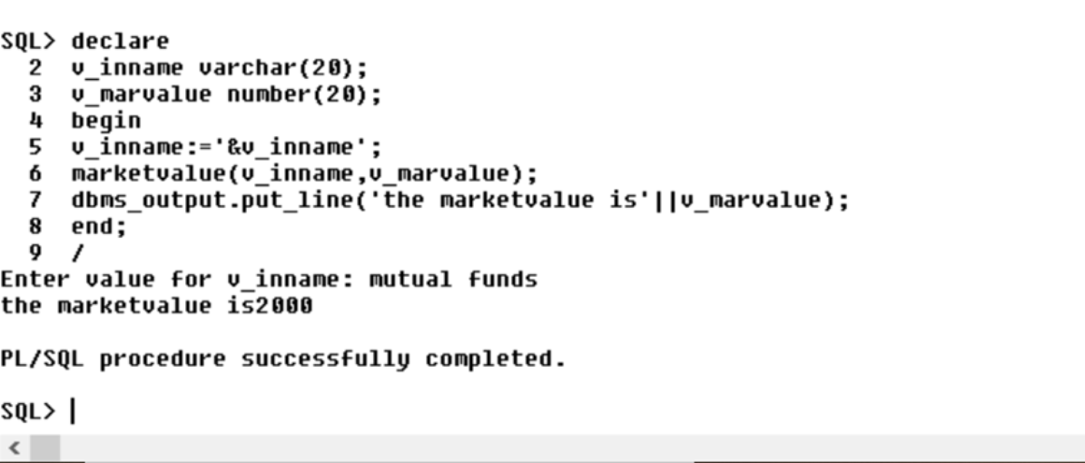
procedures
TO FIND THE MARKET VALUE OF INVESTMENT FROM THE INVESTMENT NAME:

Slide 10

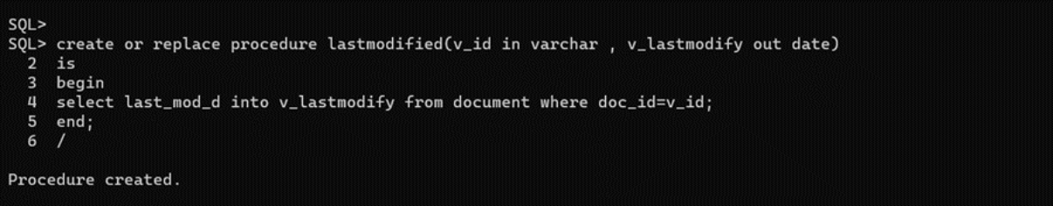
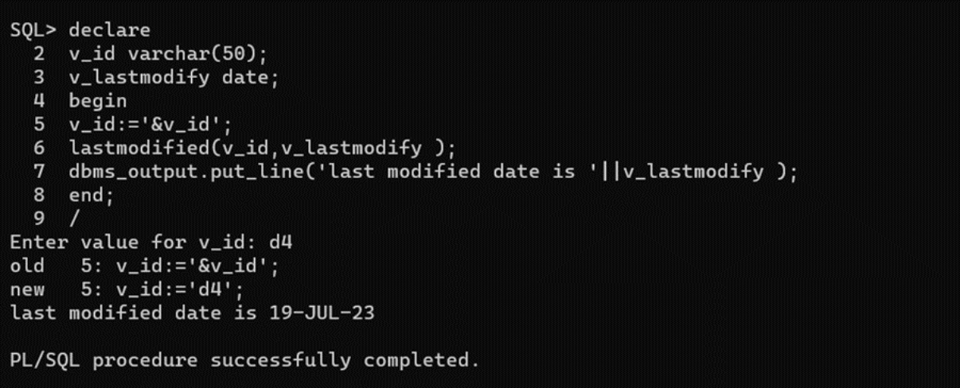
procedures
procedure to find last modified date of document by taking document id

Slide 11

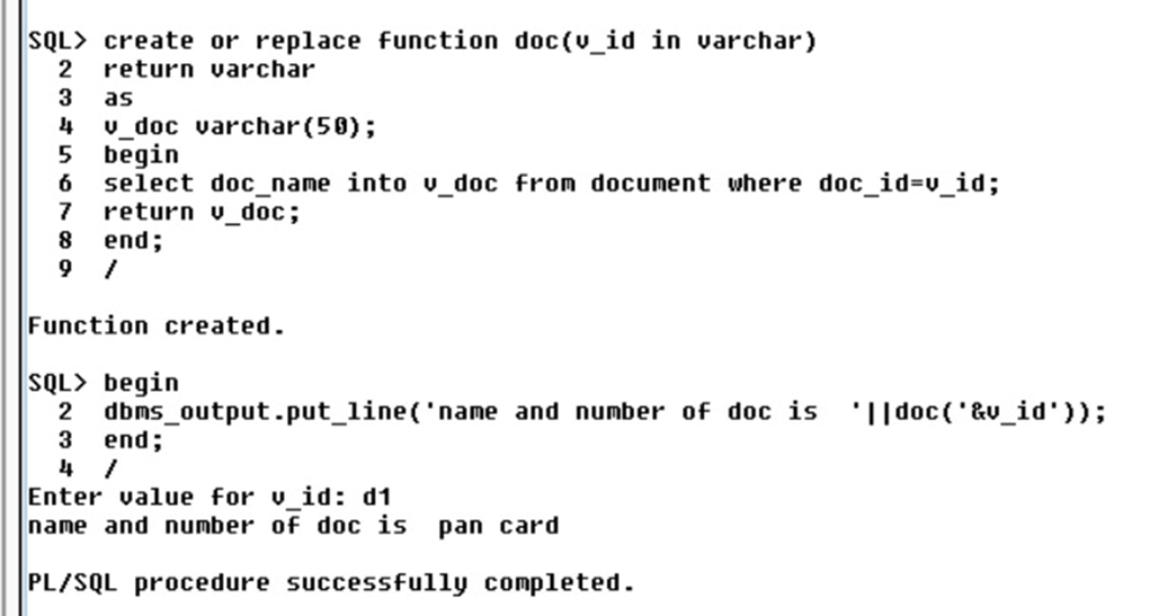
Functions
Function to show document of member by accepting member's id :

Slide 12
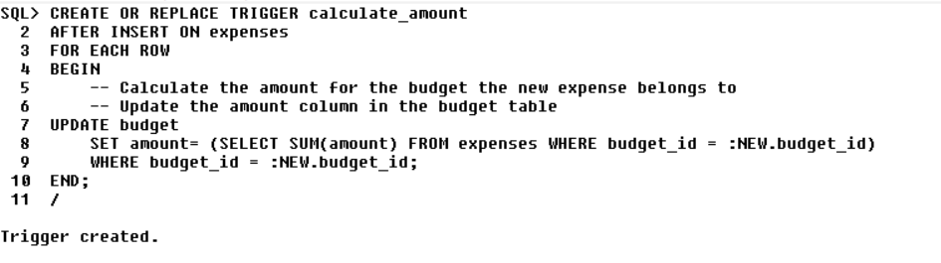
Triggers
. Trigger to update the market value of an investment when its return date is updated:

Slide 13
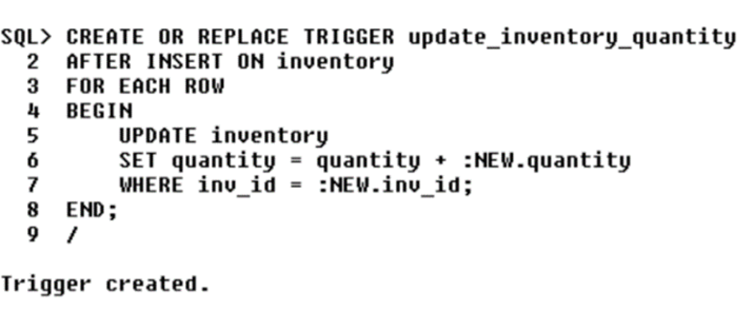
Triggers
Trigger to update the quantity of an inventory item when it is purchased:

Slide 14
conclusion
In conclusion, the Home Management System implemented within a Database Management System represents a significant step forward in the quest for efficient and organized domestic life. This project has demonstrated the potential of technology to simplify and enhance the management of various household responsibilities.
The advantages of such a system are manifold. It allows homeowners to maintain financial records, track expenses, and set budgets with ease. It keeps a comprehensive inventory of household items, ensuring that supplies are never depleted unexpectedly. It enables efficient scheduling of tasks, from cleaning and maintenance to appointments and family events. Furthermore, the database-driven approach empowers users to analyze trends and make data-driven decisions to optimize their home management strategies.

